Slide 1
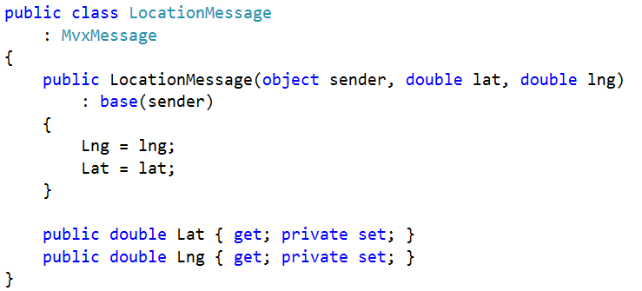
Message

Slide 2

Publish

Slide 3
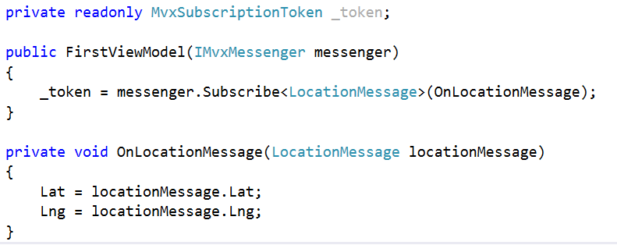
Subscribe

